Slide 1

SPRINT 5
GROUP 8
Kyle Esson
Austin Wiwarsono
Ted Ha
Mayooran Sathyendra

Slide 2
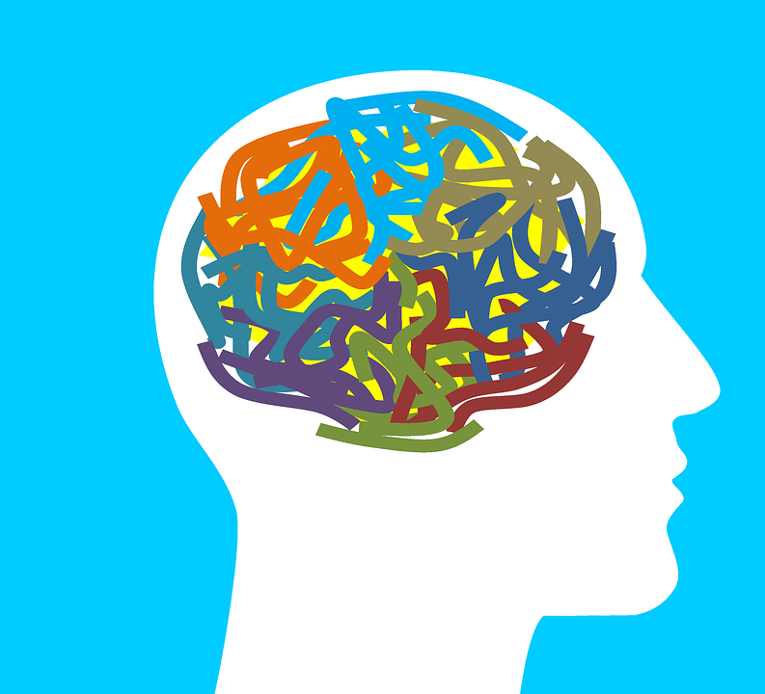
PROJECT BRIEF
The world has become more aware of their own mental health.
Awareness alone is not enough; people need to be more informed and seek professional help.
Making this information and help more accessible will significantly improve wellbeing.

Slide 3
Mayooran's User Personas
Sam Michaels
Niamh Walters
High School Student
Suffers from severe anxiety
Wants to reach information efficiently
Prefers minimal, less noisy pages.
Primarily a desktop user
Wants accessible, professional help
Workplace accountant
Undergoing immense stress
Appreciates good aggregation of information
Regularly uses both desktop and mobile

Slide 4
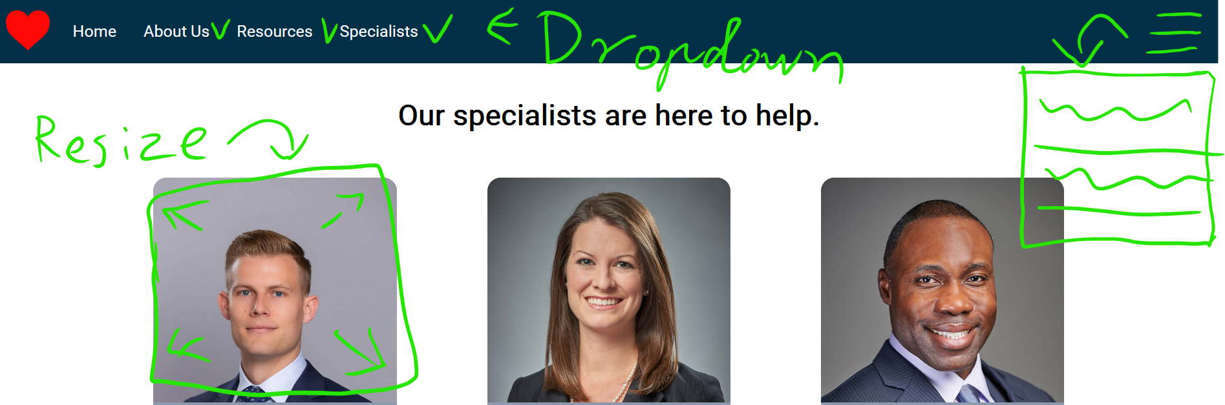
Addressing Sam's Requirements

Slide 5
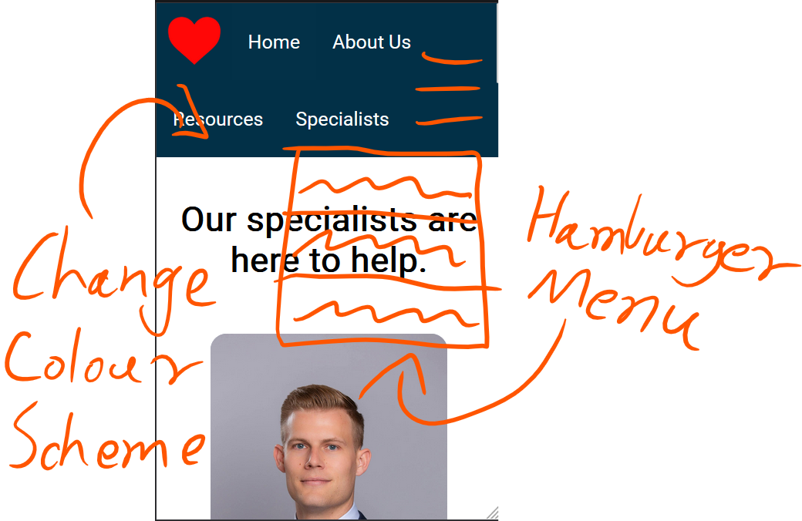
Addressing Niamh's Requirements

Slide 6
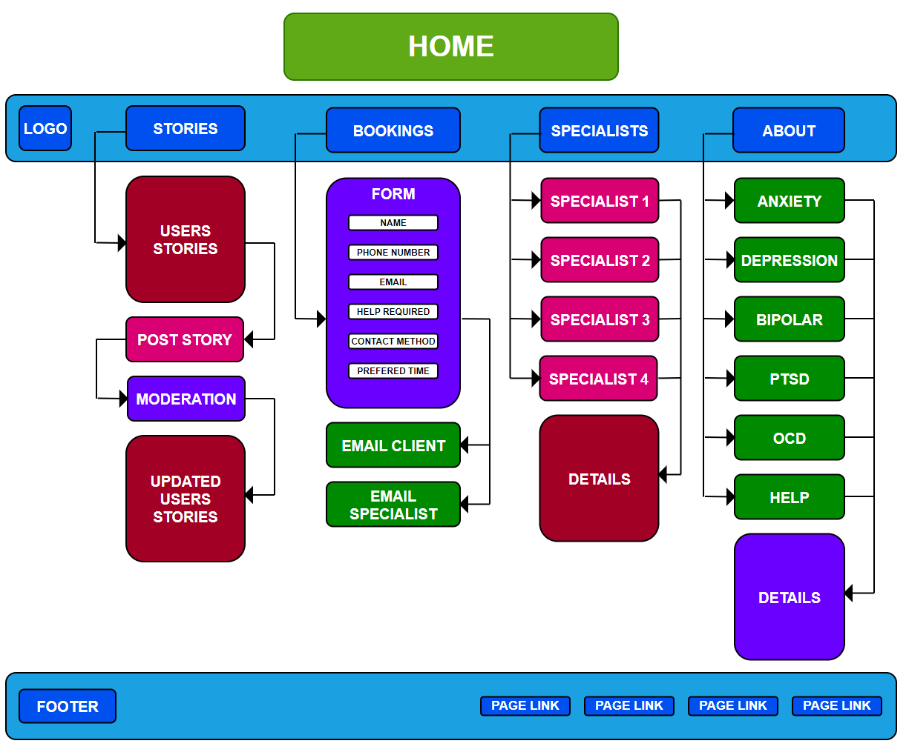
Information Architecture

Slide 7
Kyle’s User Stories
Mark
A 35-year-old sales representative named Mark has been dealing with much stress due to his busy work schedule and, as a result, has developed anxiety in his work life. One night at home, Mark researches mental health to understand his condition more. He is hesitant to get support due to the stigma around mental health issues but wants to learn more about it. Once finding the domain through a search engine, Mark discovers a booking system and sufficient information regarding his condition, which helps him recognise what he is going through. Mark also appreciates that the site does not require much navigation through different pages to search the relevant information. Mark also notices that the domain is designed in a manner to be calm and not in your face with advertisements and pop-ups.
Margaret
A 75-year-old retiree name Margaret has been living alone for some time now and has become sadder and sadder each year. She has been overhearing her children discuss the possibility of her suffering from depression. One day, Margaret decides to research depression but has always struggled with using technology. But her grandchildren have taught her how to use an iPad they gave her years ago, so she starts googling to learn more about mental health. She is also willing to talk to a professional to determine whether her children may be accurate in their diagnoses. Margaret discovers our domain and immediately notices it is easy to view and navigate using her tablet device. She also notices that the domain provides a booking system for connecting with professionals. However, booking online can be complicated for Margaret, so she is hesitant to attempt to do so.

Slide 8
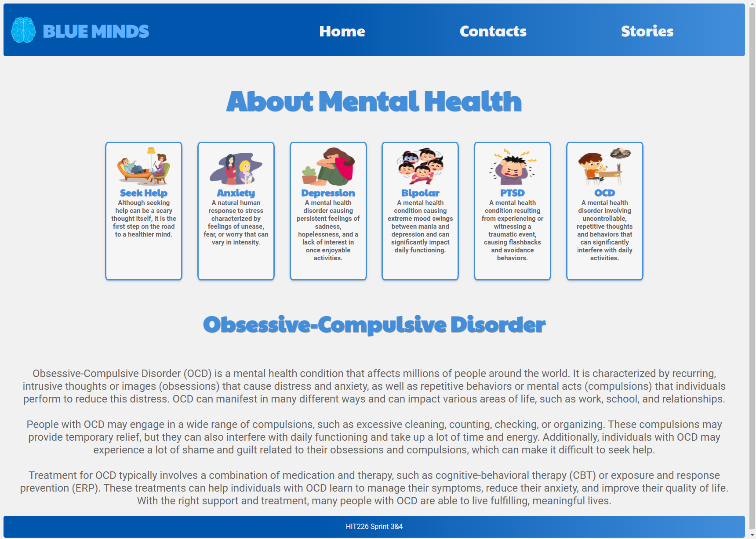
Solving Mark’s requirements

Slide 9
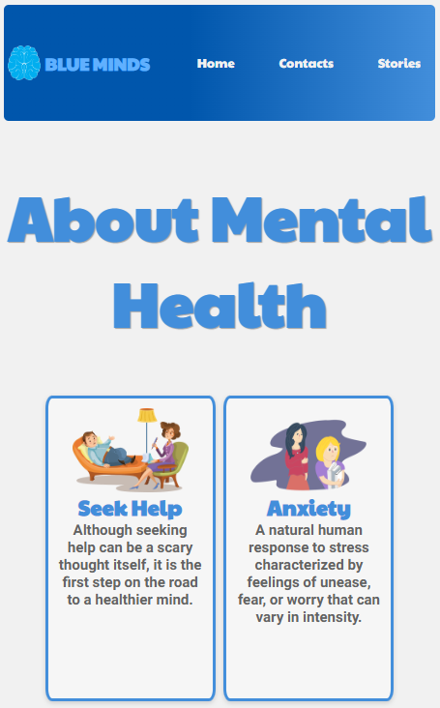
Solving Margarets requirements

Slide 10
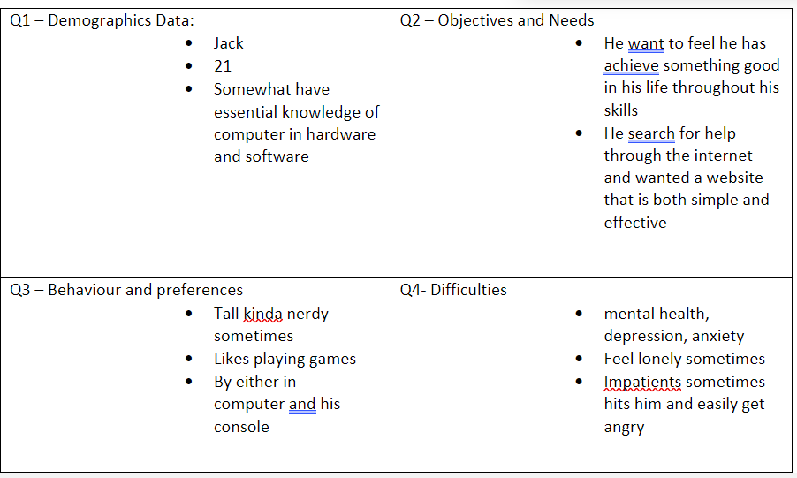

Austin's User Stories
Mike
Mike is a retired soldier from his country. He has witnessed a lot of horror in his days which cause him numbers of trauma. He mentioned that the training and the punishing missions nearly killed him but at the same time make him feel like it is part of him where he couldn’t let go. He wanted to ask through the internet but with his lack of skills in basic computer, he wanted to find an easy to access website with the help of his brother.
Jack

Slide 11
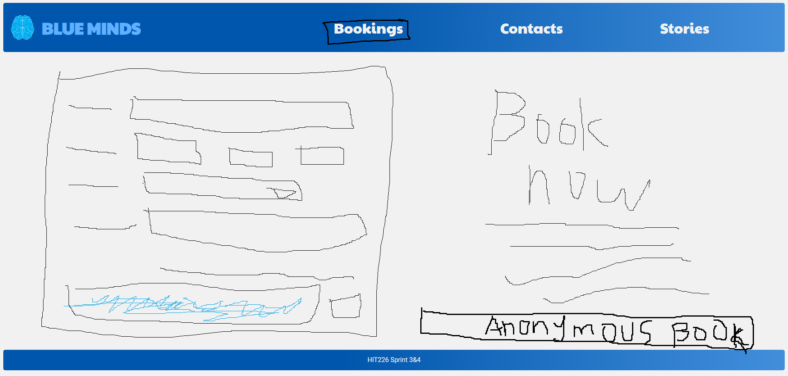
Solving Both user requirements
Austin's booking paper prototype
Simple
Effective
Easy to use for non-computer user

Slide 12
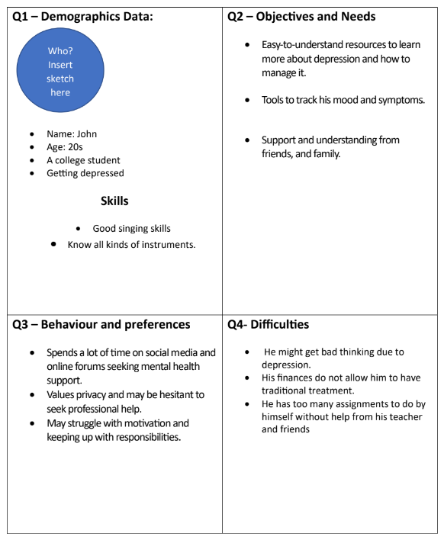
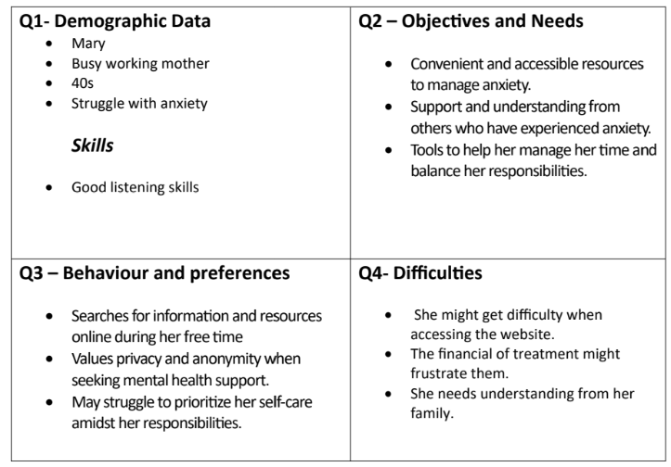
Ted User's Stories

Slide 13
